Slide 1
Billede brugt WIN_20190131_11_16_05_Pro

Slide 2
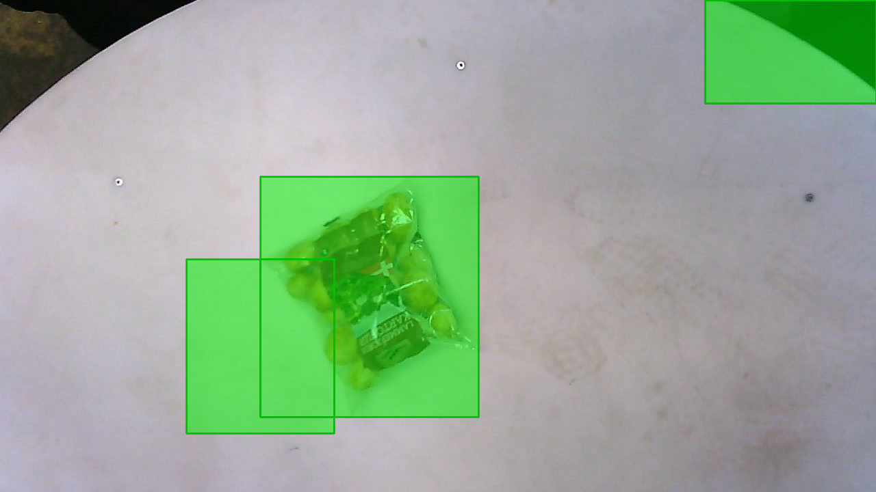
Bounding
Box
Regression
loss
Bounding
Box
Regression
loss
Classification loss
Classification loss
CNN
CNN
Bounding
Box
Regression
loss
Classification loss
CNN
Warped RoIs
RoIs
Input image

Slide 3
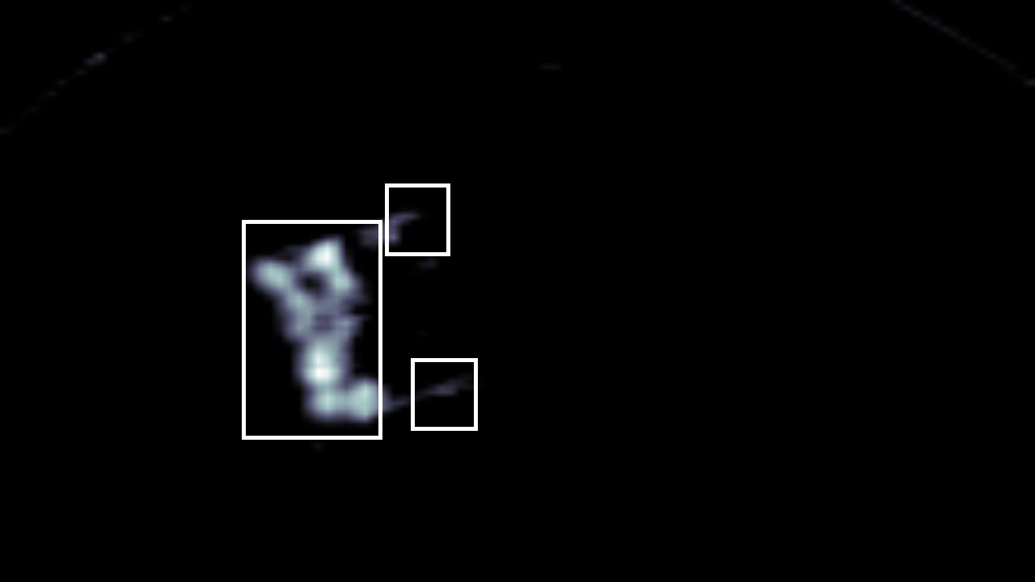
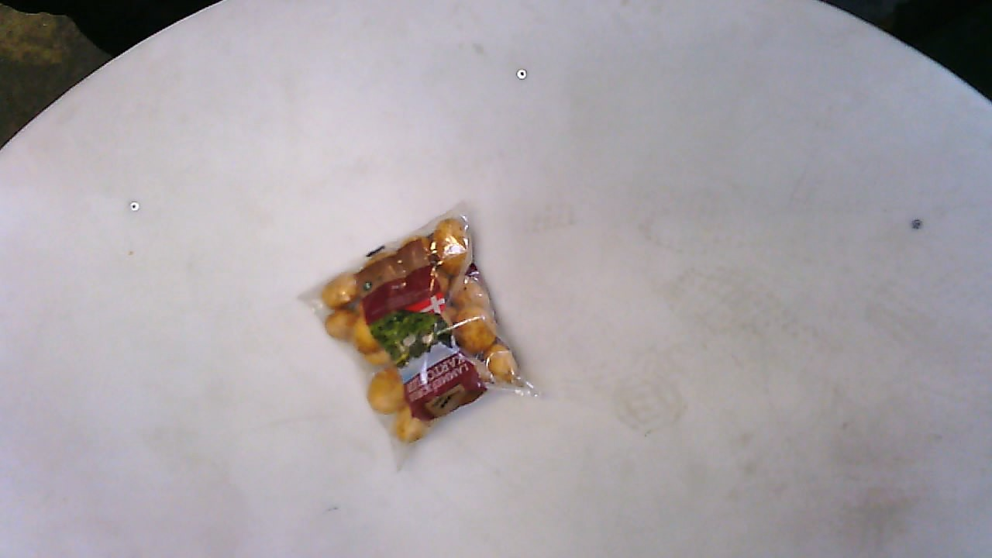
Classification loss
Bounding Box
Regression loss
FC layers
RoI Pooling layer
Feature map with RoIs
CNN
Region proposal method
Input image

Slide 4
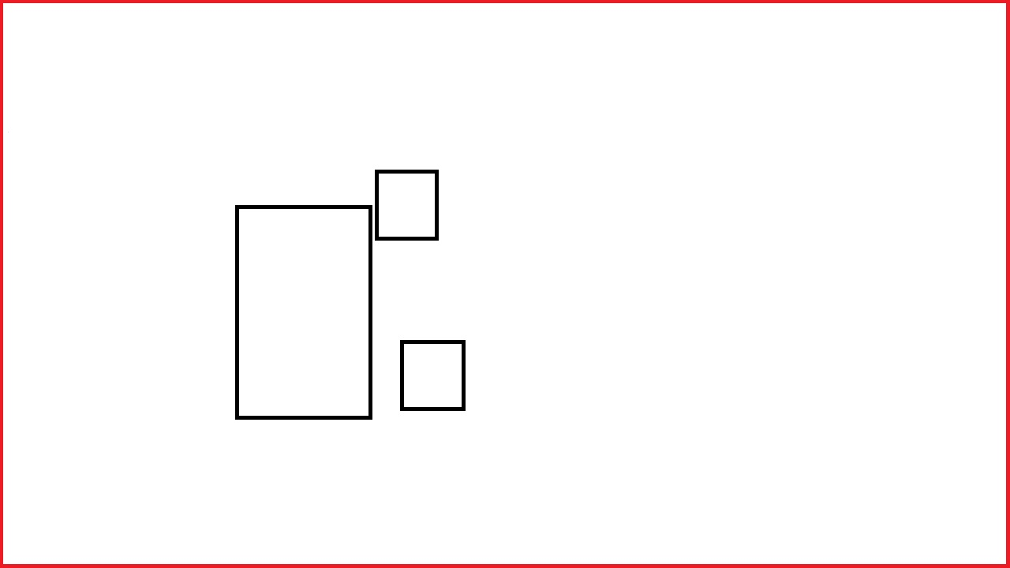

Bounding
Box
Regression
loss
Classification loss
Classification network
Bounding
Box
Regression
loss
Classification loss
RoI Pooling
Proposal regions
Region proposal network
Feature map
CNN
Input image

